Slide 1

Predicting House Prices - Advanced Regression Techniques
BY : APOORV SINGHAI
BRANCH :DATA SCIENCE AND ENGINEERING
ROLL NO : 2009068206

Slide 2

PROBLEM STATEMENT
To build a machine learning model that accurately predicts the sale price of a house, given a set of features such as square footage, number of bedrooms and bathrooms, location, and amenities.

Slide 3

IMPORTANCE OF ACCURATE PREDICTIONS IN REAL ESTATE
Informed Decision-Making: Accurate predictions help buyers and sellers make well-informed decisions. Buyers can decide whether a property is a good investment, while sellers can set appropriate asking prices.
Pricing Strategy: For sellers and agents, knowing the accurate market value of a property is essential for setting the right price. Overpricing or under-pricing a property can lead to lost opportunities and financial consequences.
Risk Mitigation: Real estate transactions often involve significant financial investments. Accurate predictions help investors and lenders assess and mitigate risks associated with real estate investments.

Slide 4
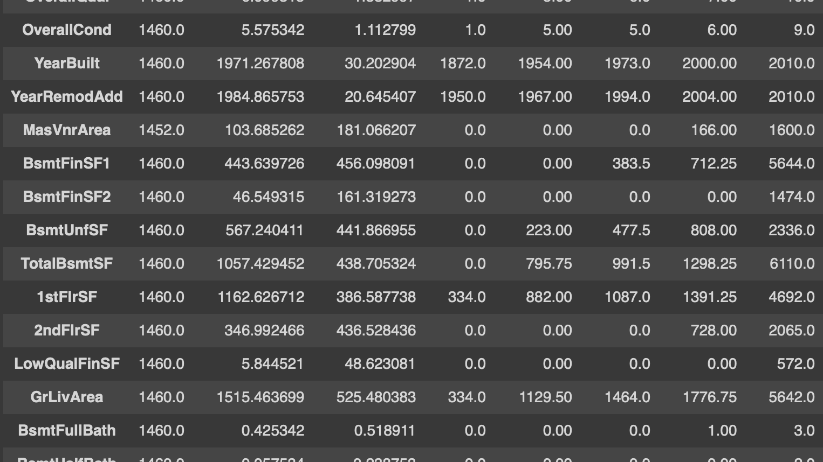
DATASET USED
A dataset was chosen which has 79 explanatory variables describing every aspect of residential homes.
Train data = house-prices-advanced-regression-techniques/train.csv
Test data = house-prices-advanced-regression-techniques/test.csv
Train.shape = ((1460, 81)
Test.shape =(1459, 80))

Slide 5
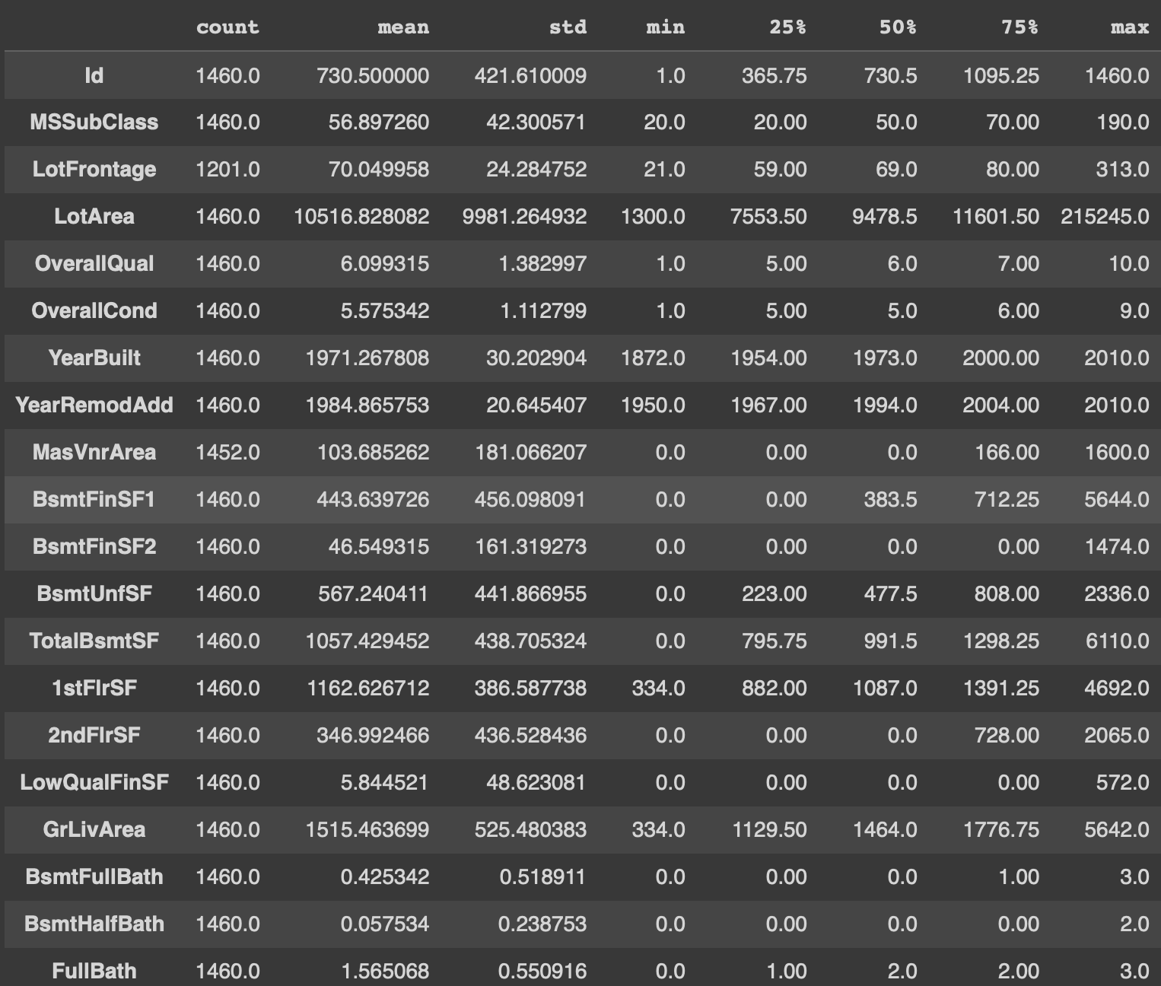
Print a concise summary and descriptive statistics of the dataset.

Slide 6
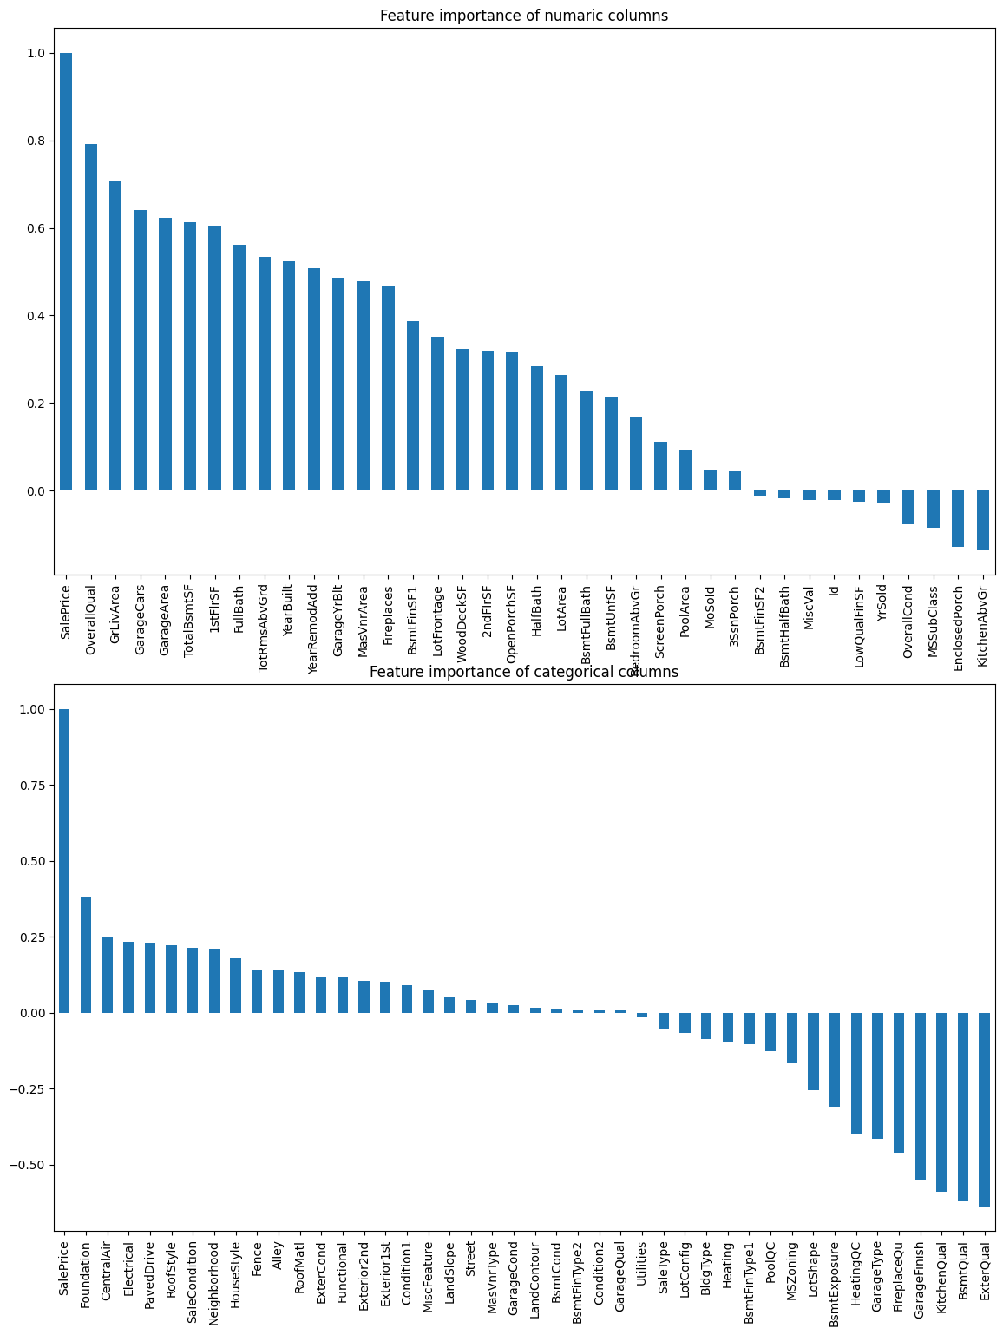
FEATURE ENGINEERING
Separate numeric columns and categorical columns
1
Find important features
2
Visualize feature importance of numerical and categorial columns
3

Slide 7

DATA PREPARATION
Drop columns where number of null values is greater than 500
Removing features with less importance. Less important features was selected by correlation score.
Check for null values and filling null values.

Slide 8
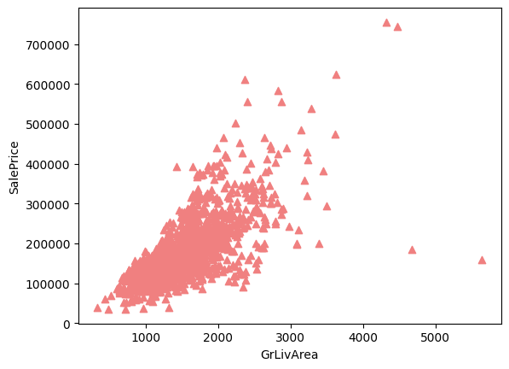
EDA
Plot a scatter plot visualizing GrLivArea and SalePrice.
There are some odd values that saying Ground living area is bigger than 4000. We will treat them as outliers.

Slide 9
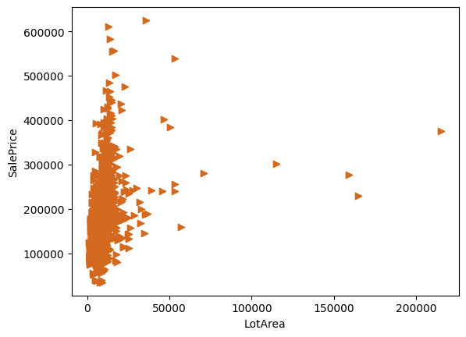
Plot another scatter plot visualizing LotArea and SalePrice.
We will consider LotArea greater than 150000 as outliers.

Slide 10
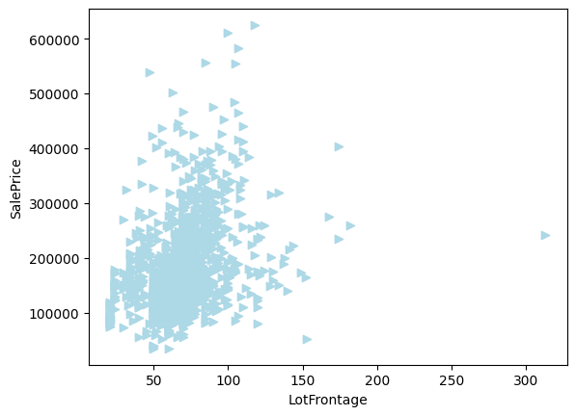
Another scatter plot of LotFrontage w.r.t SalePrice

Slide 11
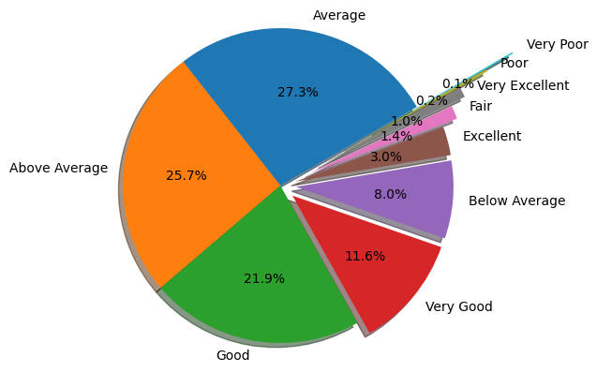
OverallQual refers overall quality of the house. This is a important feature. SalePrice largly depends on it. Because if the house quality is Very Excellent than it is more likely to be sold with high price. Let's analyse this column.
27.3% houses of the train dataset has Average quality. And 0.1% houses are Very Poor in quality.

Slide 12
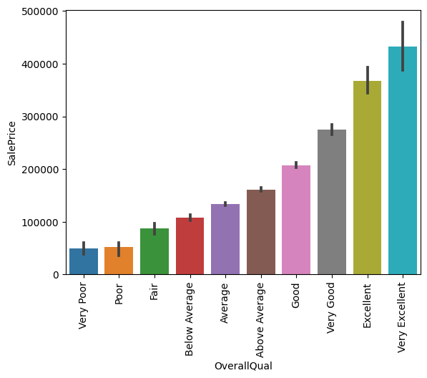
Let's see the SalePrice variation w.r.t OverallQual

Slide 13
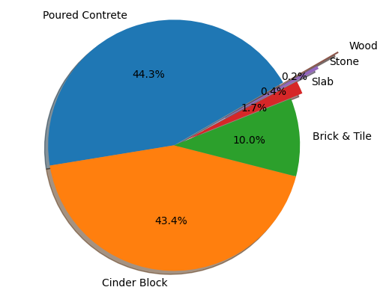
Foundation is another important feature. It represent how strong a bulding can be. Buildings life depends on it. So, this column worth analysing.

Slide 14
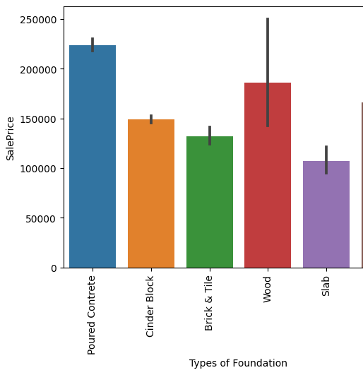
Let's see how SalePrice varies w.r.t TypeOfFoundation

Slide 15
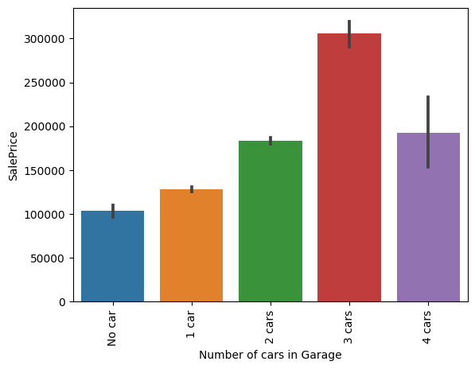
Let's see how SalePrice varies w.r.t GarageCars

Slide 16
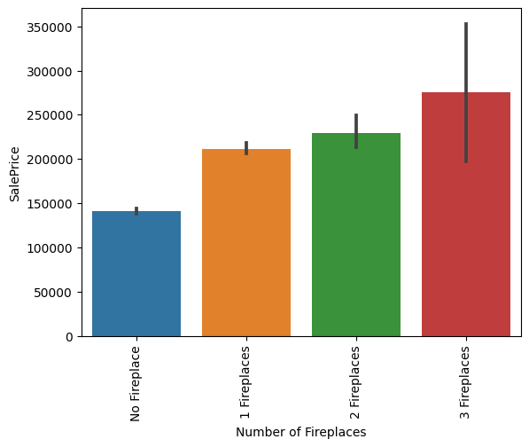
Let's see how SalePrice varies w.r.t NumberOfFireplaces

Slide 17
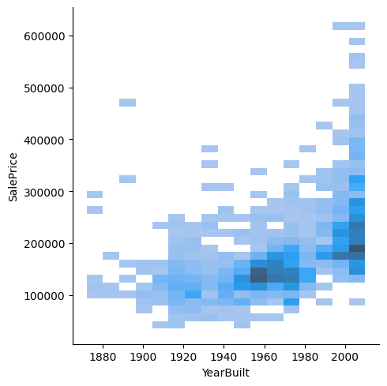
Let's plot a distribution plot of YearBuilt column representing the year of a house was bult w.r.t saleprice

Slide 18
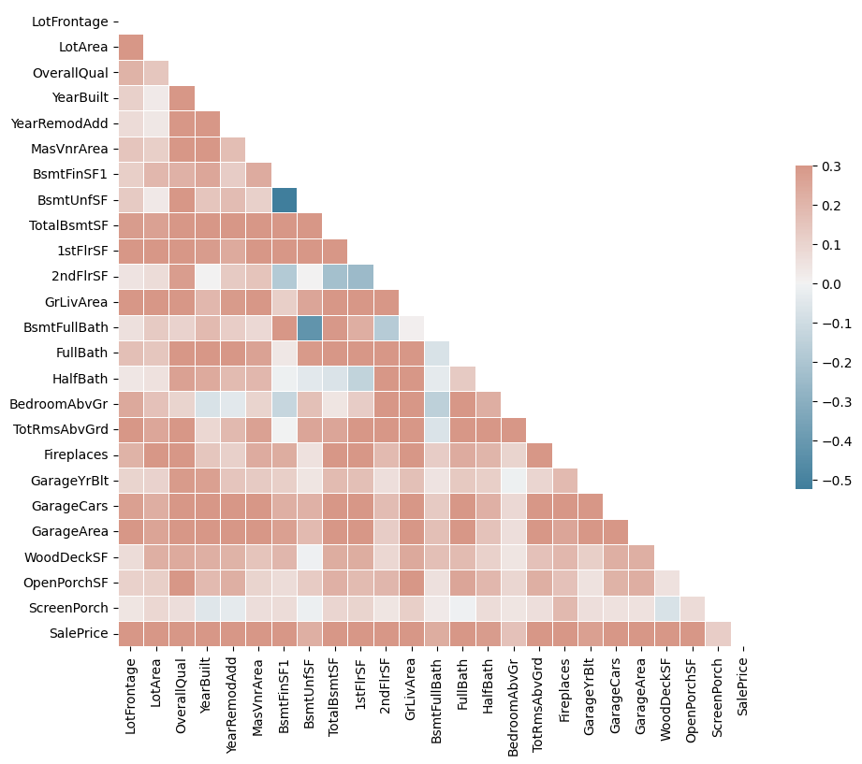

Slide 19
FEATURE ENGINEERING
Reducing Skewness and kurtosis from data.

Slide 20
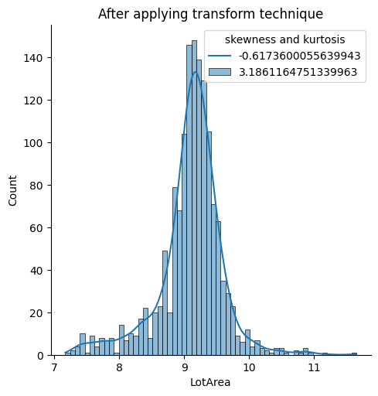
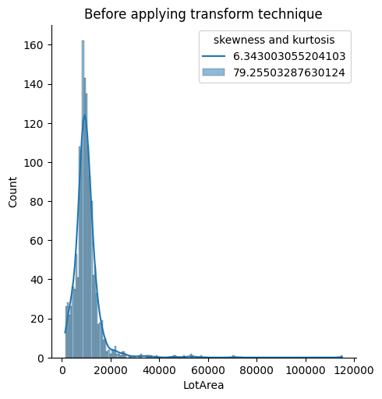

Slide 21
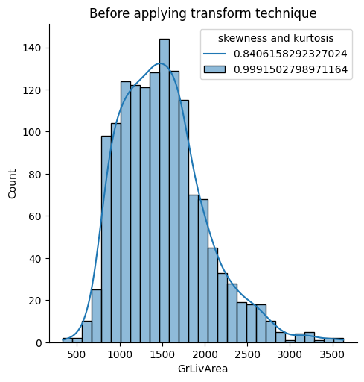
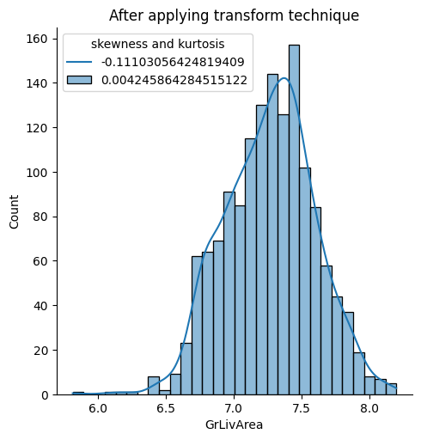

Slide 22
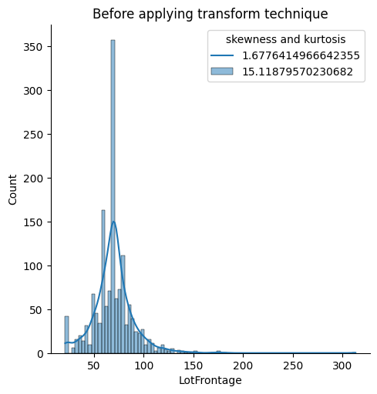
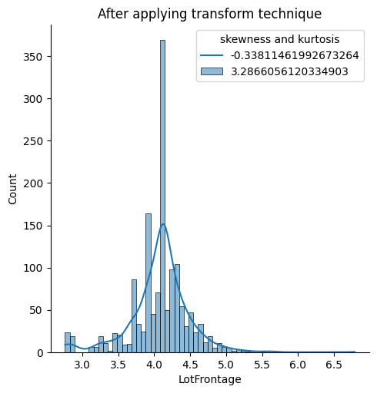

Slide 23

MODEL BUILDING
During the model building phase, we experimented with several regression algorithms, each offering unique advantages. These algorithms included:
1. Ridge Regression
2. Lasso Regression
3. Random Forests
4. Gradient Boosting Regressor
5. XGBoost

Slide 24
Why These Models Were Selected
The selection of these models was driven by specific considerations:
- Ridge and Lasso Regression: We started with Ridge and Lasso because they handle multicollinearity well, preventing overfitting and improving model interpretability.
- Random Forests: We included Random Forests for their robustness against outliers and ability to capture complex relationships.
- Gradient Boosting Regressor: Gradient Boosting excels in predictive accuracy by combining multiple weak learners.
- XGBoost: XGBoost, an advanced gradient boosting algorithm, was chosen for its speed and performance optimization.

Slide 25
MODEL EVALUATION
1.Lasso
Cross val score: 0.8278706401045717
R^2 score: 0.8563418920151011
Mean Absolute Error: 19920.254536806577
2. Ridge
Cross val score: 0.8279207755115886
R^2 score: 0.8563675882488649
Mean Absolute Error: 19915.71950193995
Cross val score: 0.8680261377161251
R^2 score: 0.8961563464770138
Mean Absolute Error: 15870.598473312402
3. Random forest
4. GradientBoostingRegressor
Cross val score: 0.8583668798091466
R^2 score: 0.8697009470457316
Mean Absolute Error: 18272.807911483636
5. Xgboost
Cross val score: 0.8776698513007686
R^2 score: 0.9111848469304623
Mean Absolute Error: 15124.044041895604

Slide 26
MODEL SELECTION
Model selection is a critical step in regression tasks due to several key reasons:
It directly impacts predictive accuracy: The chosen model significantly affects how well it predicts house prices.
It influences generalizability: The selected model's ability to generalize to new data is vital for real-world applications.
It ensures handling of unseen data: A well-chosen model should be capable of providing accurate predictions for houses not seen during training.
The diverse set of models we explored allowed us to find the most suitable one for our dataset, which ultimately led to improved predictive capabilities. This extensive model selection process is essential to maximize the performance of our machine learning solution.

Slide 27
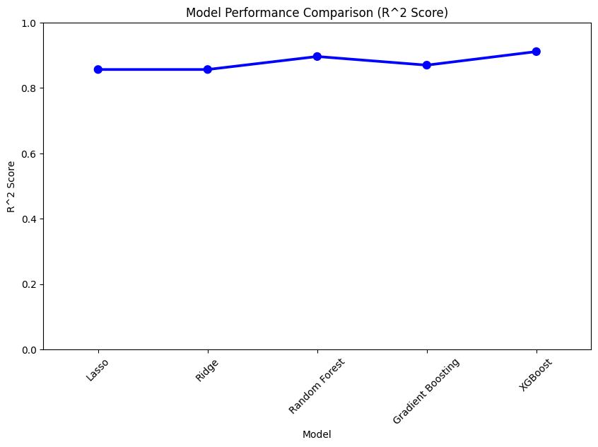
Identify the best performing model

Slide 28
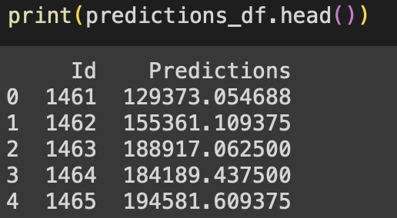
OUTPUT
Predicted output using Xgboost model on given test data set

Slide 29
THANK YOU

